Slide 1

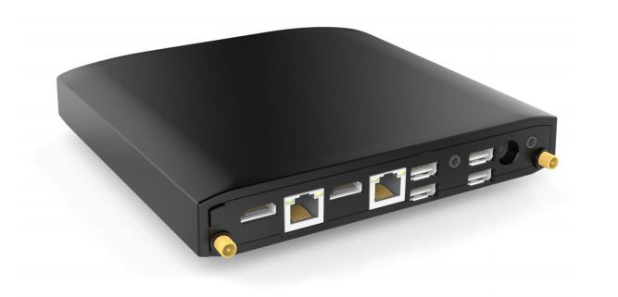


Slide 2

Mototrbo GSM Telephone Gateway
Great flexibility
Easy to install
Small in size

Slide 3
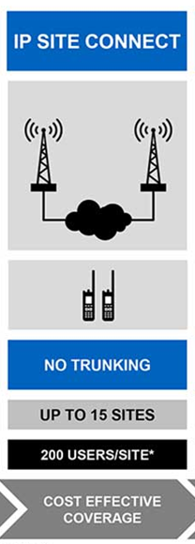
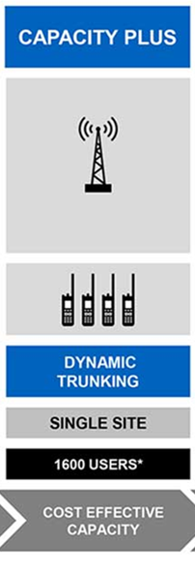
In what networks can it be used?
IP Site Connect Capacity Plus

Slide 4
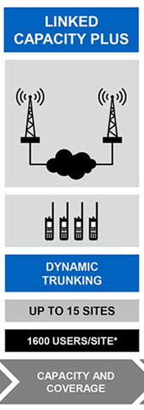
What about Linked Capacity Plus?
For incomming calls only, one DMRVoice Link required in the total netwok.
Call-out will than only be possible if you are under coverage of the site with the DMRVoice Link.
To achieve full call-out/call-in function, one DMRVoice Link per site is applicable

Slide 5
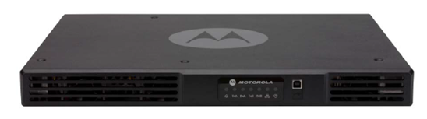
Required Mototrbo equipment:
SLR5500, MTR3000 or DR3000 repeater
HKVN5056A Digital Phone Patch License key
HKVN4212A NAI License Data on all repeaters in the network.
DP/DM2000, DP3441, SL4000 or DP/DM4000 Mototrbo terminals (display models if text messages is required).

Slide 6
What can the DMRVoice Link do for you?
Provides capability to call in/out from the Mototrbo network, even if the terminals are in areas outside GSM coverage. Repeater with VoiceLink connected has to be wihtin GSM coverage.
First telephone interface providing Text messaging capabilities, both ways between terminal and telephone.
Alarm signal transmitted from terminal to Smartphone, with GPS position displayed om map.

Slide 7

Potential customer groups:
Emergency organisations
Power companies
Fish Farming
Mining
Constructors

Slide 8
Specifications:
CPU AMD G-T40E, Dual Core, 1.0GHz 6.4W
Memory 2GB
Storage 64 GB SSD
Operating System Windows 7 PRO desktop
Graphics Radeon HD 6250 GPU, Dual display mode supported
Display 2 x HDMI 1.4a (up to 1920 x 1200 @ 60Hz)
Audio Digital 7.1+2 channels S/PDIF and analog, IN & OUT
I/O 4 x USB 2.0 ports, 1 x micro SIM slot
LAN 2x GbE LAN ports,
Advanced Features CPU Virtualization, Auto-On, Wake-on-LAN, Wake-on-Timer, PXE Boot, Watchdog
Input Voltage Unregulated 10-15VDC input
Power Consumption 7W – 15W
Operating Temp 0 – 70°C
Supported frequencies GSM 850, 900, 1800, 1900

Slide 9
DMRVoice Link increases the workers safety with it’s unique alarm feature including GPS positioning.
DMRVoice Link increases the productivity by use of Text messaging between GSM phone and terminal.
DMRVoice link increases the flexibility with incomming and outgoing phone calls from your terminals, also with group calls

